Slide 1
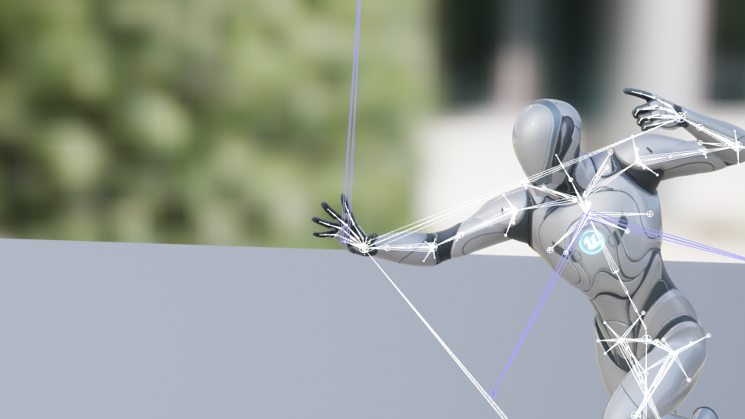
UNREAL NEURAL
Runtime Animation Generator
Unreal Engine Plugin

Slide 2
This Week’s
Update
Implemented UE Runtime Retargeter
Completed MDM Augmentation
0.

Slide 3
Motion Diffusion Model
BEFORE
Unreal Engine
Plugin Structure
Text Input
Model
Motion Data
Dimension
Conversion
FBX Data
Text Input
Animation
State
Retargeting
Animation
Sequence
Runtime
Importer
1.
Unreal Engine
Notes:
Our original implementation. Unreal engine part pipeline is restructured.

Slide 4
Motion Diffusion Model
AFTER
Unreal Engine
Plugin Structure
Text Input
Model
Motion Data
Dimension
Conversion
FBX Data
Plugin
Manager
FBX Data
Runtime
Retargeter
Animation
Sequence
Text Input
Player
Character
Character
Component
1.
Animation
Montage
Unreal Engine
Notes:
It’s new version. we introduced PluginManager to control our plugin more easily.
Instead of exporting animation sequence from fbx and retarget later, we combined does step.

Slide 5
Motion Diffusion Model
Plugin Manager
Text Input
Model
Motion Data
Dimension
Conversion
FBX Data
Plugin
Manager
FBX Data
Runtime
Retargeter
Animation
Sequence
Text Input
Player
Character
Character
Component
2.
Animation
Montage
Unreal Engine

Slide 6
Plugin Manager
Bridge Between Components
MDM Server Connection
Hold Plugin Configuration
Server
Plugin
Manager
FBX Data
Runtime
Retargeter
Animation
Sequence
Text Input
Character
Component
Notes:
Plugin manager is in charge of…

Slide 7
Motion Diffusion Model
Character
Component
Text Input
Model
Motion Data
Dimension
Conversion
FBX Data
Plugin
Manager
FBX Data
Runtime
Retargeter
Animation
Sequence
Text Input
Player
Character
Character
Component
3.
Animation
Montage
Unreal Engine
Notes:
Character component is plugin component that will be attached to a character that will play animation.
Connect our plugin to a user characater
Offers three blueprint functions

Slide 8
Character Component
User Interaction
Input: User Text
Output: Animation Sequence
Easy to use
Target Configuration
Set IKRig, Character

Slide 9
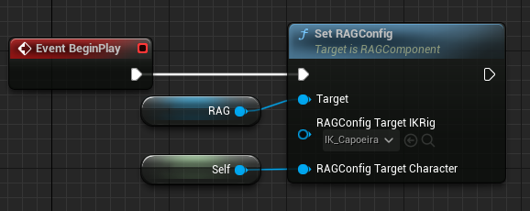
Character Component
Set RAGConfig()
Set target IKRig and Character
Notes:
Set IKRig and character.
IKRig contains bonechain information. Which target bone will be mapped to our source bone.
Set character which character you want to apply the generated animation to.

Slide 10
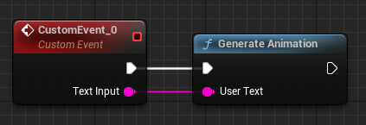
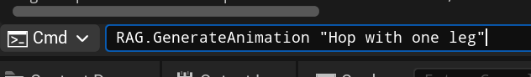
Character Component
2. Generate Animation()
Get text input from a character to generate animation
Can be called from Command
Notes:
Connect this function to your implementation.
We also provide command for generating animation.

Slide 11
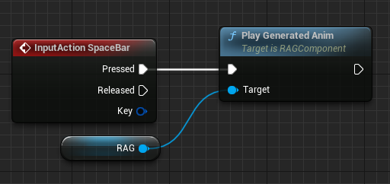
Character Component
3. Play Generated Anim()
Get text input from a character to generate animation
Notes:
Simply connecting custom event to our function, you can play the generated animation.

Slide 12
Motion Diffusion Model
Runtime
Retargeter
Text Input
Model
Motion Data
Dimension
Conversion
FBX Data
Plugin
Manager
FBX Data
Runtime
Retargeter
Animation
Sequence
Text Input
Player
Character
Character
Component
4.
Animation
Montage
Unreal Engine

Slide 13
Runtime Retargeter
Set Bone Mapping
Map source bone chain to target bone chain.
Get Motion Data From FBX
Find motion data using source bone name in FBX
Generate AnimSequence To Target Skeleton
Add animation track to target bone name
Source Bone Name: avg_L_Shoulder
Target Bone Name: LeftArm
Notes:
Actually 2, 3 is not separated step. Instead of generating animation on the source skeleton, apply the motion to target skeleton.

Slide 14
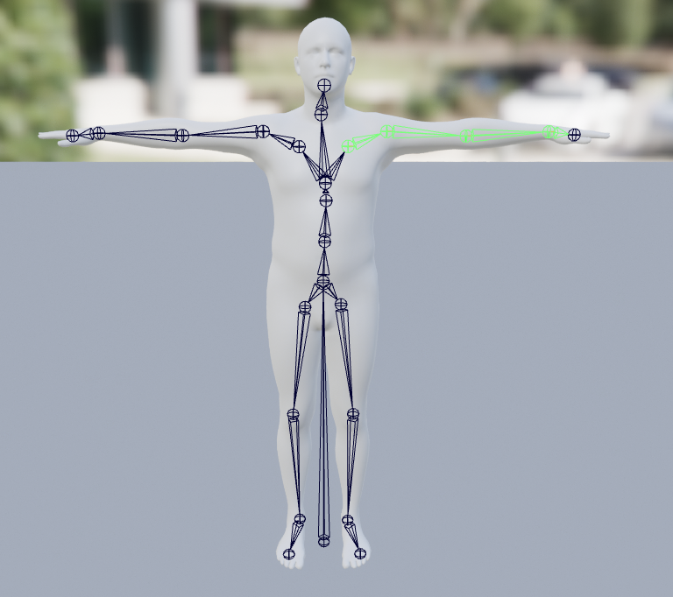
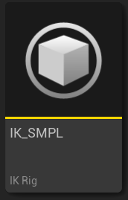
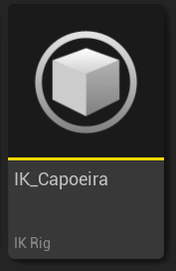
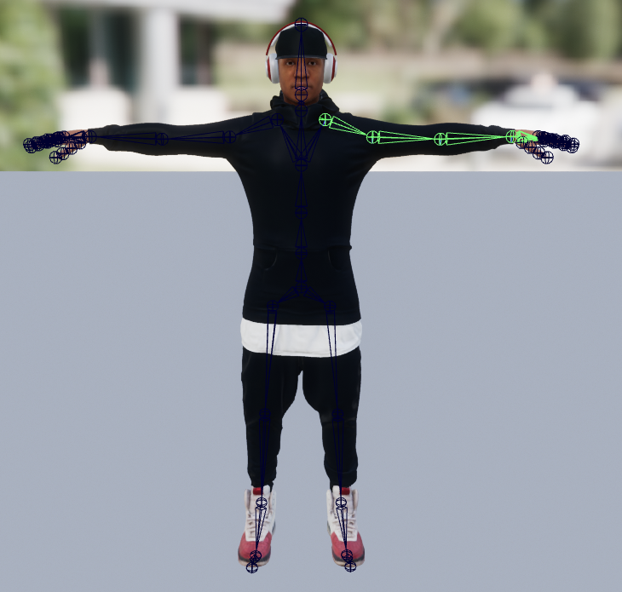

Runtime Retargeter
1. Set Bone Mapping
Create Map <SourceBoneName, TargetBoneName>
ChainName: LeftShoulder
[LeftShoulder, LeftArm, LeftForeArm, LeftHand]
ChainName: LeftShoulder
[m_avg_L_Collar, m_avg_L_Shoulder, m_avg_L_Elbow, m_avg_L_Wrist]
Plugin
User

Slide 15
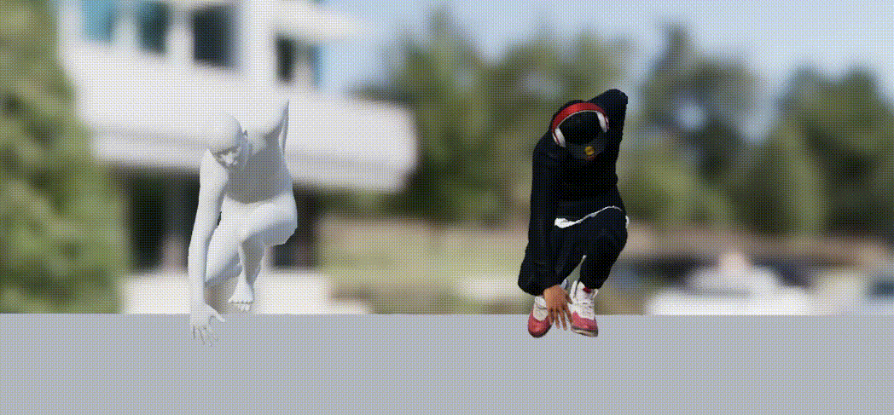
Runtime Retargeter
GOAL: Implement it in RUNTIME
Notes:
This is our retarget goal. You might say you already done it. But it’s not in runtime. We have to do it in runtime.

Slide 16
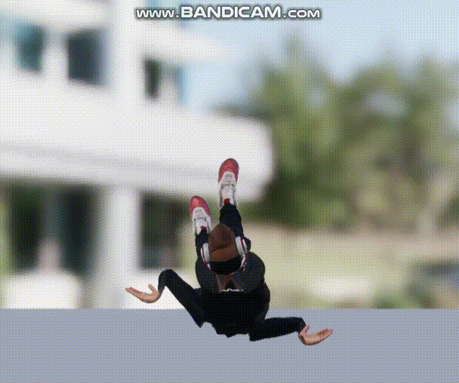
Runtime Retargeter
Issue:
Axis Orientation mismatch between FBX format and unreal engine.

Slide 17
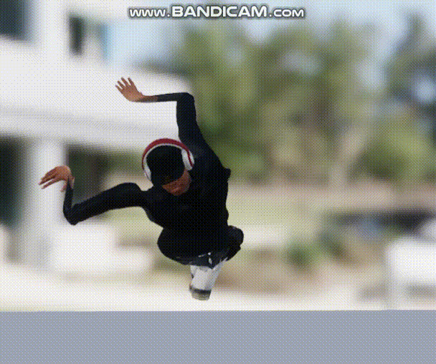
Runtime Retargeter
Issue:
In-between bones are not transferred.

Slide 18
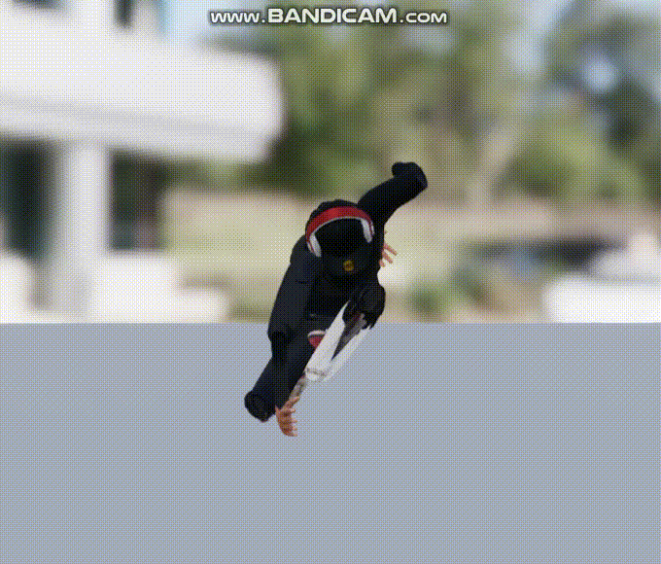
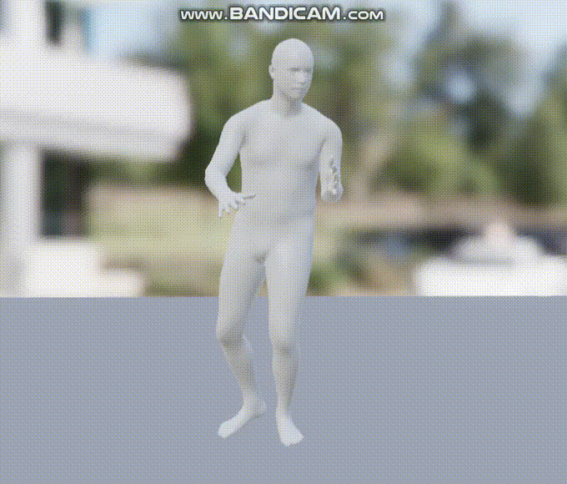
Runtime Retargeter

Slide 19
Motion Diffusion Model
Augmentation Result
Text Input
Model
Motion Data
Dimension
Conversion
FBX Data
Plugin
Manager
FBX Data
Runtime
Retargeter
Animation
Sequence
Text Input
Player
Character
Character
Component
5.
Animation
Montage
Unreal Engine

Slide 20
Augmentation Result
What is difference from original model?
We adapted augmentation which can make model to create motion more expressively
It takes about 36hours with RTX 2080
We will show the effect of augmentation with the word “Enthusiastically”
 | Before | After
Merrily | 3 | 36
Regrettably | 3 | 28
Enthusiastically | 6 | 32
Fearfully | 4 | 27
Comically | 7 | 37
Defiantly | 9 | 39
Notes:
Aug 전과 후의 단어 수 결과

Slide 21
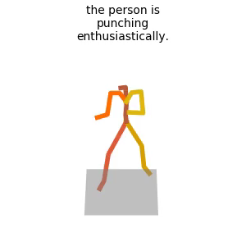
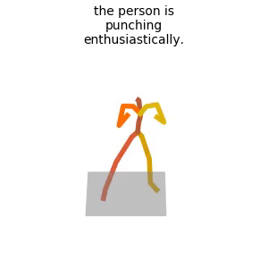
Augmentation Result
What is difference from original model?
The motion from the augmented model shows more expressive motion
The motion from the original model just punching
Original model
Our model
Augmentation
Notes:
감정을 나타내는 모션을 평가하는 것은 굉창히 애매할 수 있다.

